Slide 1
SystemC Lab
Shin-haeng Kang
shkang@iris.snu.ac.kr
Digital System Design Methodology
2016-03-18

Slide 2
What am I missing in the previous class?
Statically compiled ISS?
When you need SystemC?
Can you use legacy C code in SystemC?

Slide 3
Types of Instruction set simulator
Interpret
Execute
Interpretive ISS
Single inst
Target Binary
C Code generation
Intermediate C code
Host Code Build
Host Executable Code
All insts
Statically compiled ISS
Basic block
Look up translation cache
Execute
Dynamic binary translation (DBT)
Translated Cache
Host Code Build

Slide 4
Statically Compiled ISS vs Normal Compiling
Why is it for?
Cross Compiler
C code Generation
Host Compiler
Target Code
Target Binary
Intermediate C code
Host Executable Code
Both functional/timed simulation are possible
Characteristics of the target binary are preserved
Target Code
Host Compiler
Host Executable Code
Functional simulation may be possible (unless target code contains target-specific code)
Characteristics of the target binary are gone away.

Slide 5
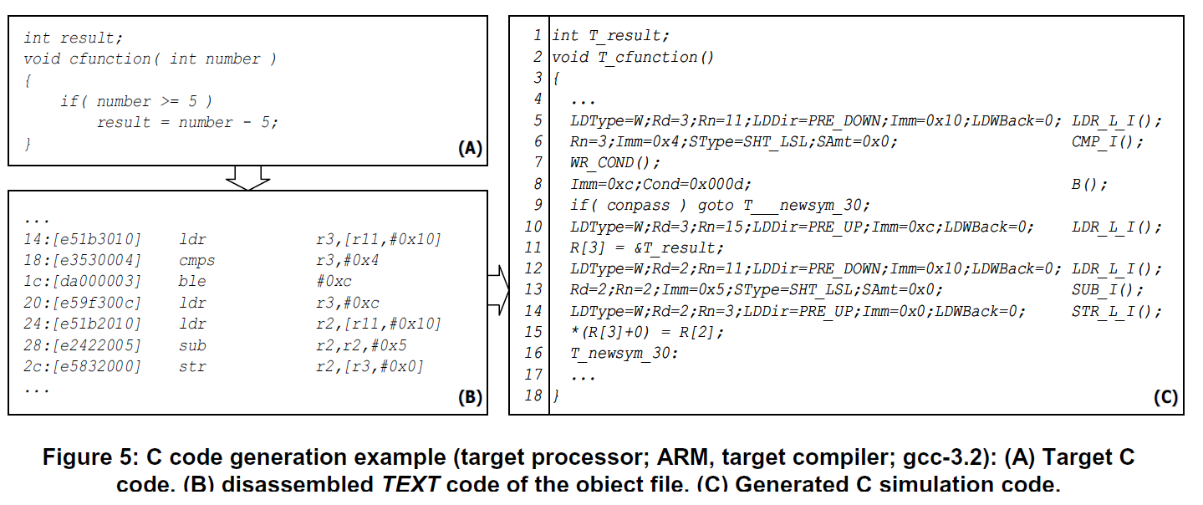
Example) Statically Compiled ISS

Slide 6
SystemC
A set of C++ classes and macros to support system-level design
Motivation
Even Verilog or VHDL’s behavioral modeling is not high-level enough
People generally use C or C++
Developed by OSCI (Open systemC initiative)
Open-source
http://accellera.org/downloads/standards/systemc
Support both TLM and RTL modeling
Does not have to use multiple languages to use multiple level of abstractions.

Slide 7
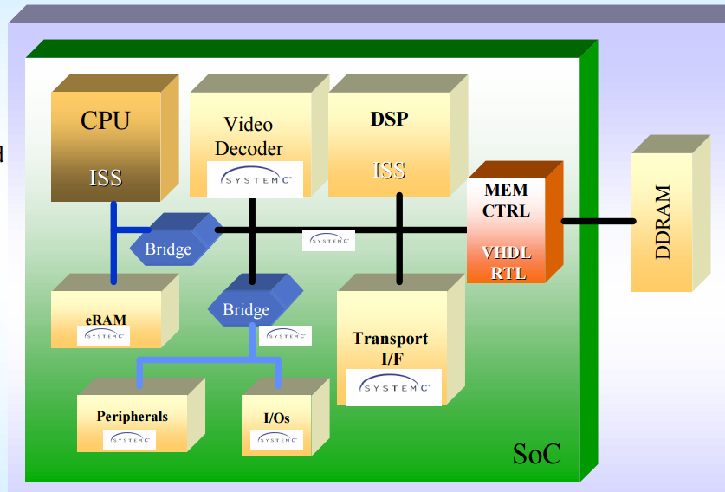
HDL and SystemC
SystemC deliberately mimics the hardware description languages VHDL and Verilog, but is more aptly described as a system-level modeling language.
SystemC is more on higher abstraction level than HDLs
SystemC is better for co-simulation of software firmware and hardware components.
You can focus on communications. You can program a process as you like in C++ semantics.
Including stdin/stdout/stderr and C++ standard libraries

Slide 8
TLM-style modeling
Motivation
Increase simulation speed
Reduce modeling effort
Allow for easier model adaptability
Enable efficient architecture exploration
Enable parallel HW and SW development based in virtual prototypes
Measure
Interaction between SystemC Modules is abstracted
Function calls instead of signals
Based on sc_interface

Slide 9
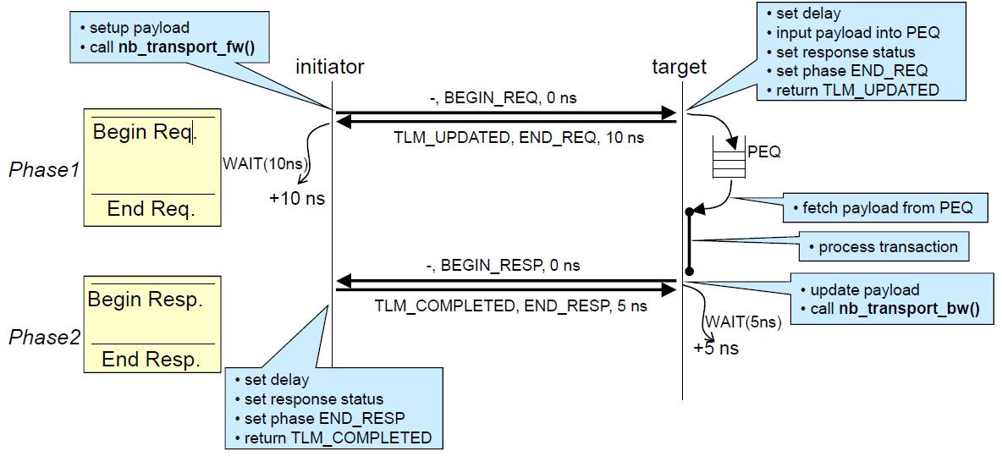
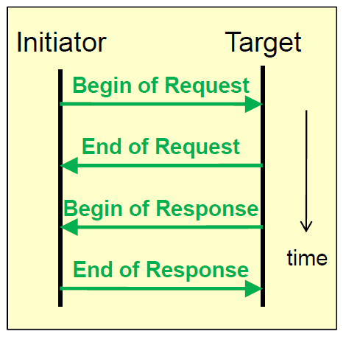
SystemC with TLM
General characterization of a transaction between initiator and target in max. 4 phases
Begin / end of request
Begin / end of response

Slide 10
Temporary LOG-IN ID and password
If you have your own, use it.
Otherwise, use a temporary login ID
Choose Digital Systems Design Methodology
Choose Not listed? -> type “dsdm2016”

Slide 11
Server LOG-ID
Download an SSH application
http://mobaxterm.mobatek.net/MobaXterm_v8.6.zip
Connect to tyrell.snu.ac.kr
Login ID
Default password: “defaultpasswd”
Change the default password to your owns.
Student ID | Login ID
30752 | Student01
81455 | Student02
82421 | Student03
22693 | Student04
31434 | Student05
21235 | Student06
21276 | Student07
22147 | Student08
22895 | Student09
22907 | Student10
23299 | Student11
31048 | Student12
31050 | student13
31052 | Student14
31054 | Student15
21189 | Student16
21217 | Student17
21229 | Student18
30281 | Student19

Slide 12
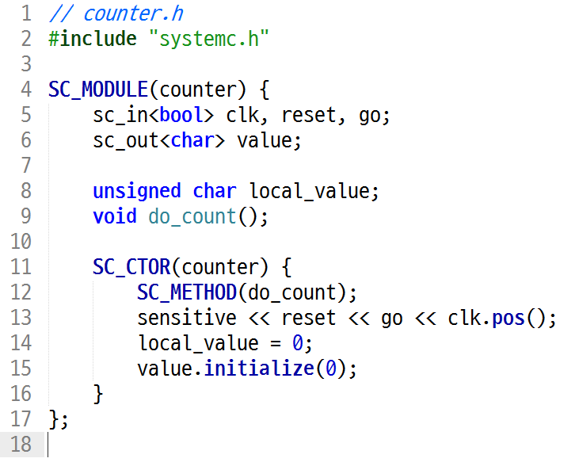
Modules: Basic Unit of Design
Syntax (RTL style)
SC_MODULE(module_name) {
/* port declaration */
/* local channel(signal) declaration */
/* variable declaration */
/* process declaration */
/* other method declaration */
/* submodule declaration */
/* constructor */
SC_CTOR(module_name) {
/* module instantiation and channel binding */
/* process registration */
/* sensitivity list */
/* module variable initialization */
}
}

Slide 13
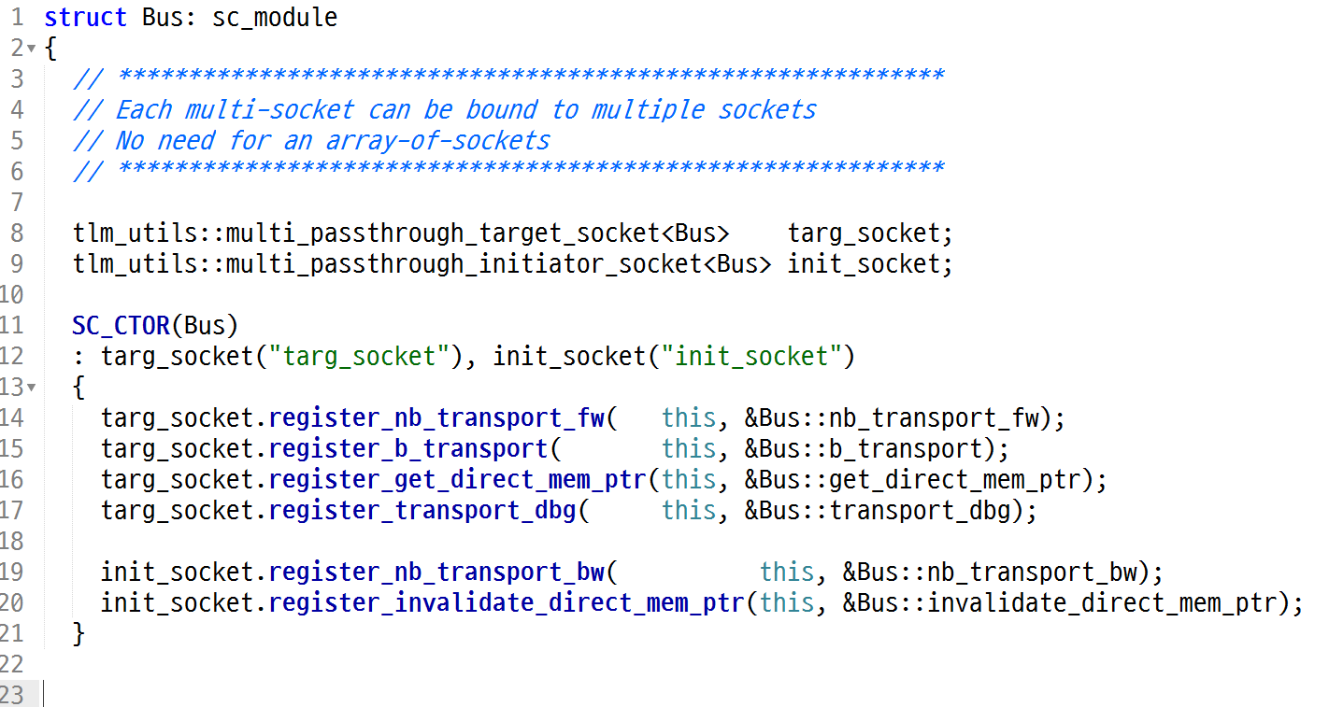
Modules: Basic Unit of Design
Syntax (TLM style)

Slide 14
SystemC Ports (pin-level)
Define the interface to each module
Three types of ports depending on the direction
Input: sc_in
Output: sc_out
Bidirectional: sc_inout
Syntax
sc_in{out,inout}<data_type> port_name;
ex) sc_in<bool> clk, reset, go;

Slide 15
SystemC Processes
Processes have sensitivity lists, i.e. a list of signals that cause the process to be invoked, whenever the value of a signal in this list changes.
method
behaves like a function
threads
Keeps executing or waiting for some event to occur.
cthread : a special thread.
The sensitivity list is just the specified clock edge.

Slide 16
SystemC Processes
 | SC_METHOD | SC_THREAD | SC_CTHREAD
Infinite loop | No | Yes | Yes
construct | SC_METHOD(pro) sensitive(sig); sensitive_pos(sig); semsitive_neg(sig); | SC_THREAD(pro); sensitive(sig); sensitive_pos(sig); semsitive_neg(sig); | SC_CTHREAD(pro, clock.pos()); SC_CTHREAD(pro. clock,neg());
suspend | NA | wait() | wait(); wait(n*);
local variable | lost | saved | saved
Static sensitivity | signal events | signal events | clock edge
Dynamic sensitivity | next_trigger(ev); | wait(ev) | wait_until(exp); watching(exp);
Usage | Comb. logic | Behavior, test bench | FSM

Slide 17
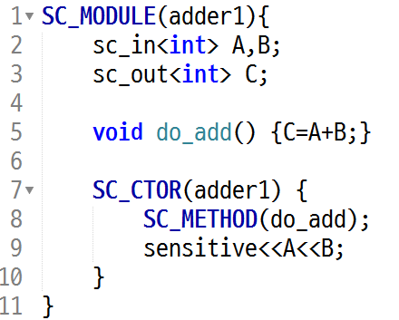
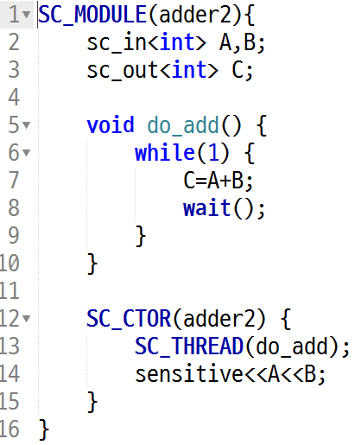
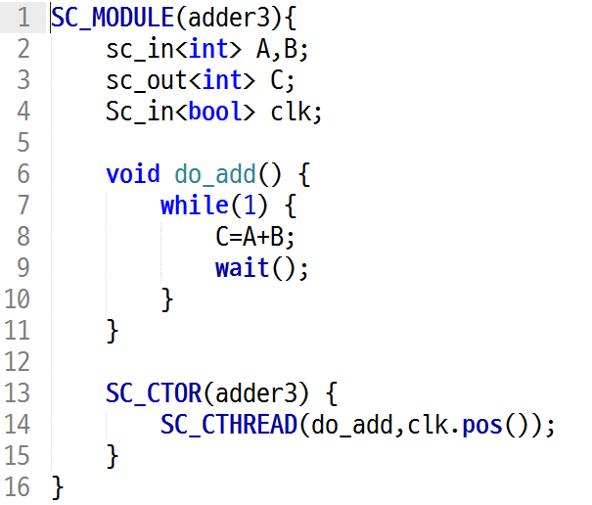
Processes:examples

Slide 18
Sensitivity List
Determine when to trigger the process
Static sensitivity: defined in SC_CTOR
sensitive << event [<< event]…; //streaming style
sensitive(event [, event]…); //functional style
Dynamic sensitivity: defined inside the process definition
SC_METHOD: next_trigger(event)
SC_THREAD: wait(event)
SC_CTHREAD: wait_until(expression)
SC_CTHREAD: watching(expression)
Defined on process registration to restart the process when the expression is met.

Slide 19
Timing in SystemC
Time in SystemC
units: SC_SEC, SC_MS, SC_US, SC_NS, SC_PS, SC_FS
“sc_time” class defines a time object (ex) sc_time t(15, SC_NS)
Define the time unit
sc_set_default_time_unit(1, SC_NS): set the default time unit
sc_set_time_resolution(1,SC_NS): set the default time resolution
The default is SC_PS if omitted
Keep track of the current simulation time: cout << sc_time_stamp()<<endl;
Clock
The only thing in SystemC that has a notion of real time
sc_clock name(“name”, period, duty_cycle, first, rising) or sc_clock name(“name”, period, time_unit, duty_cycle, first, first_time_unit, rising)
first: time elapsed until encounters the first edge
rising: set “TRUE” if the first edge is rising or “FALSE” if falling

Slide 20
Channels (1)
SystemC has two types of channel : primitive and hierarchical
Primitive channels
Contains no hierarchy, no processes.
Designed to be very fast due to their simplicity.
sc_signal, sc_buffer, sc_mutex, sc_fifo, sc_semaphore
module
module
Channel
channel
process
process
process
interface
interface
port
interface

Slide 21
Channels (2)
Both supports 1 writer & multiple readers
Basic methods
read(), write(), delayed(), event(), etc
Evaluate-update protocol
New value is visible after the current process is suspended
Difference
sc_buffer generates an event at every write() while sc_signal generates an event only when the value is changed.
You will see the difference through the lab.

Slide 22
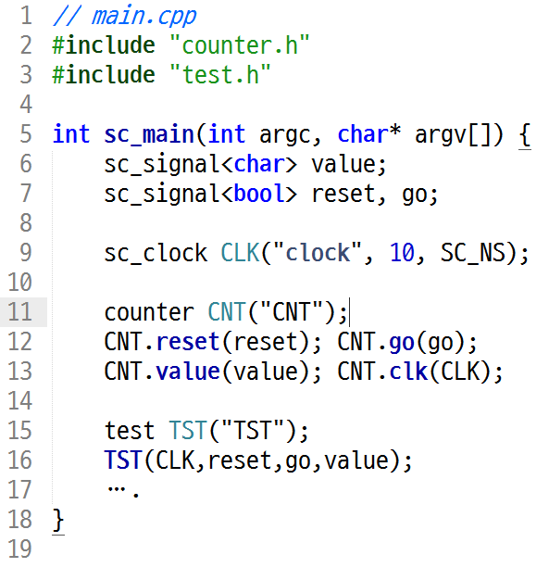
Signals
Convey information between sub-modules within a module
Port of sub-module defines the direction of data transfer

Slide 23
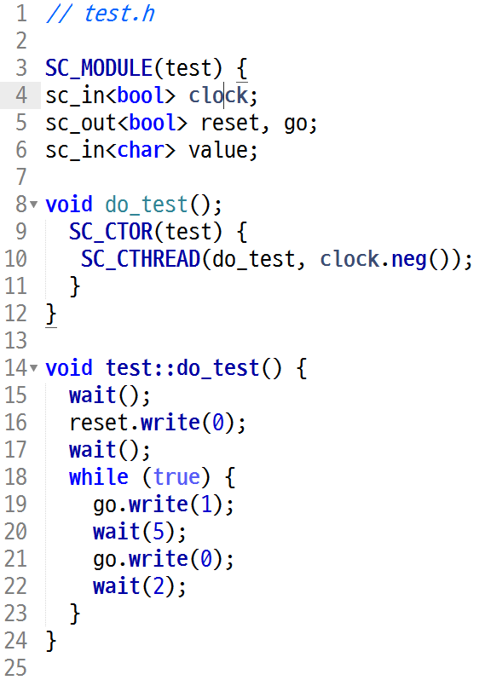
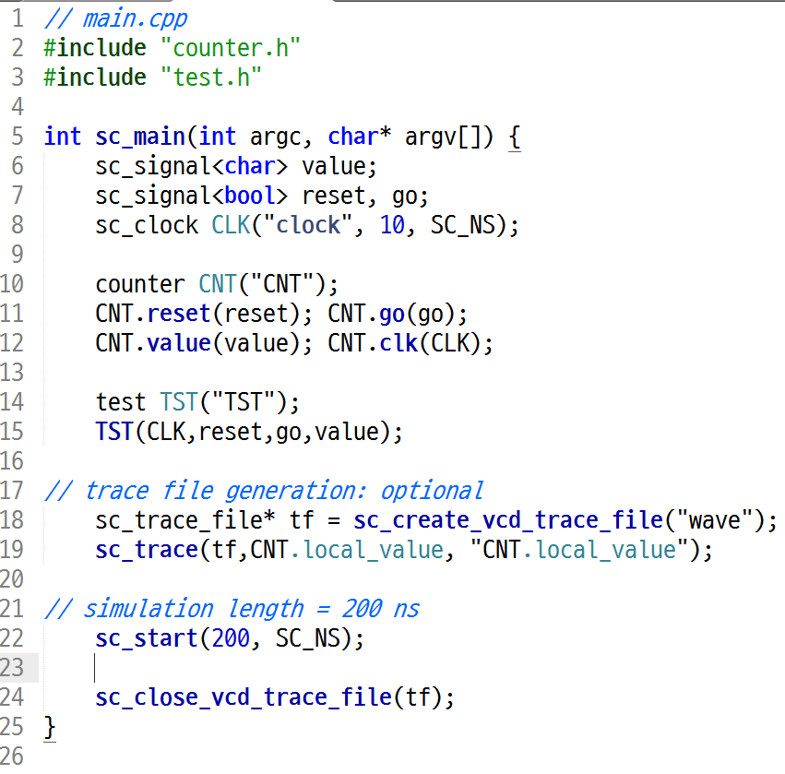
Test Bench Module and Main File

Slide 24
SystemC Examples-1
Simple adder program
Adder_method : SC_METHOD
Adder_thread1 : SC_THREAD, sensitivity – clk
Adder_thread2 : SC_THREAD, sensitivity – a, b
Adder_thread3 : SC_THREAD, sensitivity – a, b, clk
Adder_cthread : SC_THREAD
Compare SC_METHOD, SC_THREAD, SC_CTHREAD

Slide 25
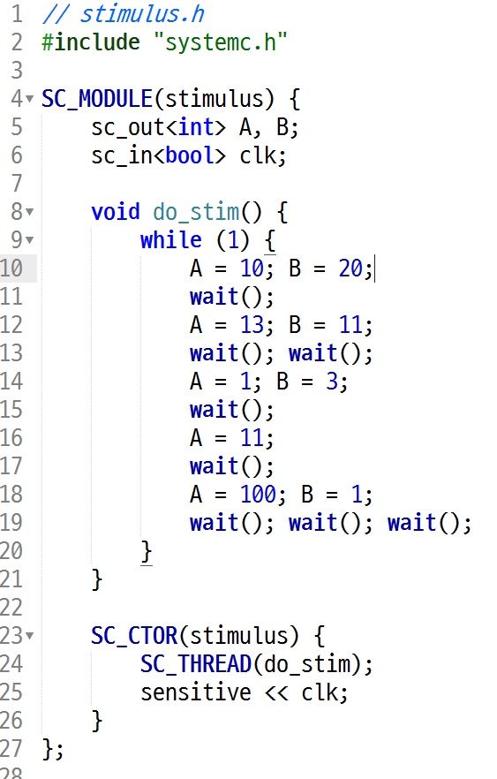
SystemC Examples-1
stimulus
A
do_stim
(SC_THREAD)
B
clk

Slide 26
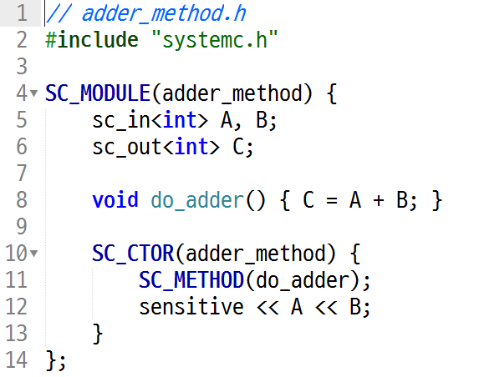
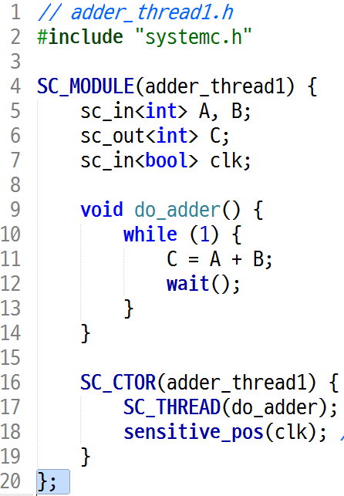
SystemC Examples-1
adder_method
A
do_adder
(SC_METHOD)
B
C
adder_thread1
A
do_adder
(SC_THREAD)
B
clk
C

Slide 27
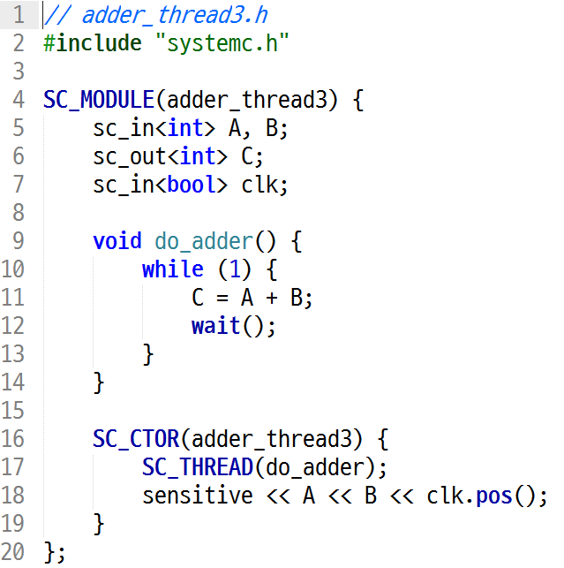
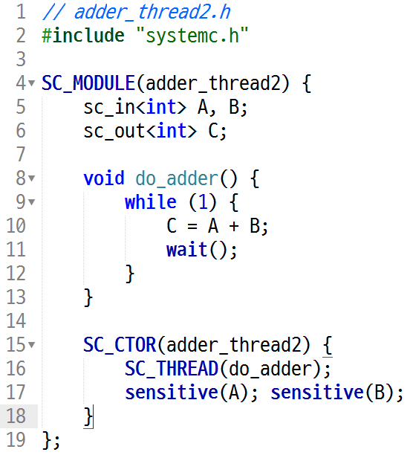
SystemC Examples-1
adder_thread2
A
do_adder
(SC_THREAD)
B
C
adder_thread3
A
do_adder
(SC_THREAD)
B
clk
C

Slide 28
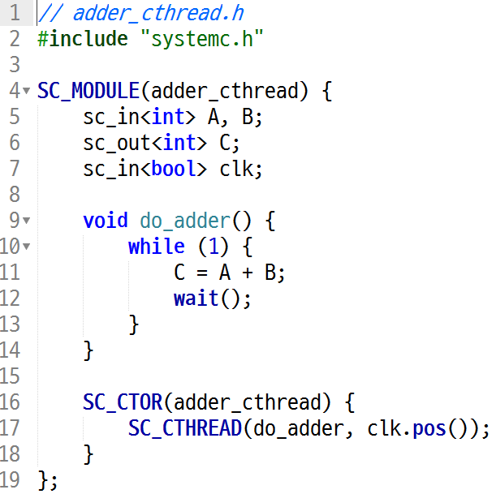
SystemC Examples-1
adder_cthread
A
do_adder
(SC_CTHREAD)
B
clk
C

Slide 29
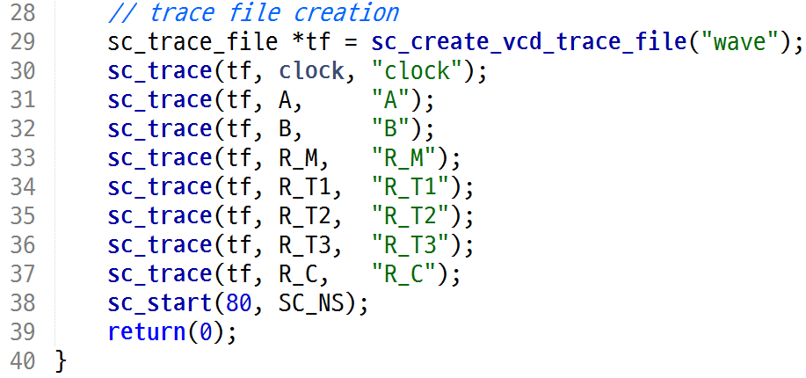
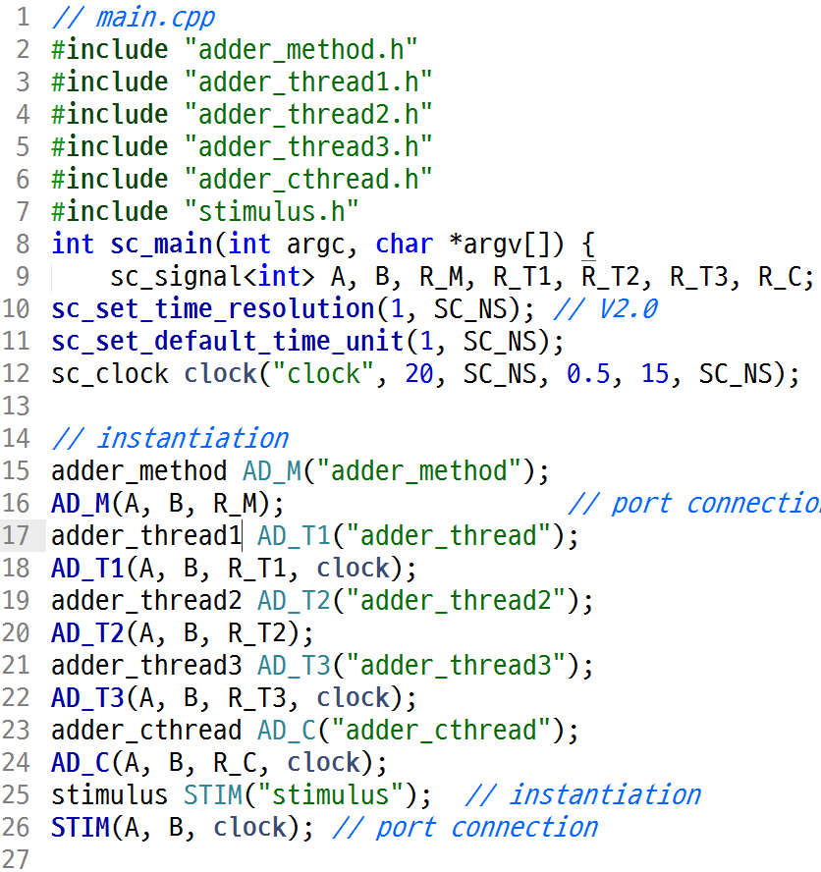
SystemC Examples-1
AD_M
(adder_method)
clock
(clock)
AD_T1
(adder_thread1)
STIM
(stimulus)
AD_T2
(adder_thread2)
AD_T3
(adder_thread3)
AD_C
(adder_cthread)

Slide 30
SystemC Examples-1
Build the simulator
export LD_LIBRARY_PATH=$LD_LIBRARY_PATH:/usr/local/systemc/lib-linux64
g++ -O3 -Wall -Wno-deprecated -g -I/usr/local/systemc/include -c main.cpp
g++ -O3 -Wall -Wno-deprecated -g -I/usr/local/systemc/include -L/usr/local/systemc/lib-linux64 -o run.x main.o -lsystemc -lm 2>&1 | c++filt
Execute
./run.x

Slide 31
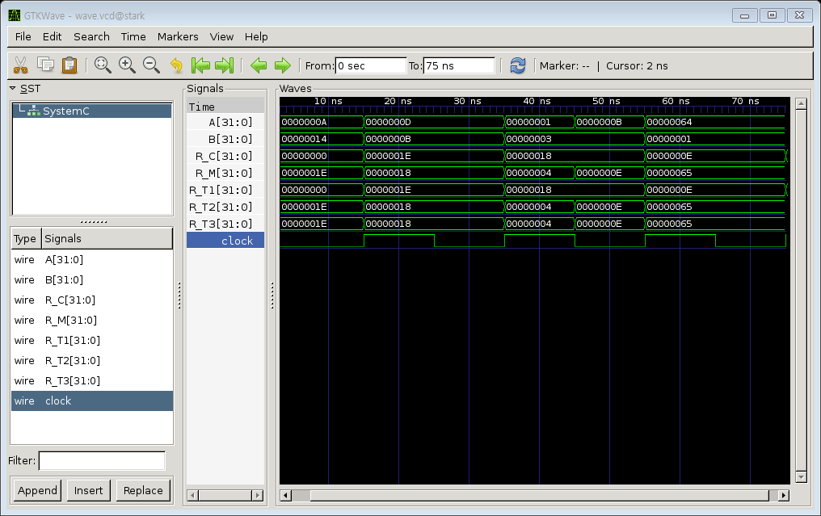
SystemC Examples-1 result
Gtkwave wave.vcd

Slide 32
SystemC Examples-2
Simple signal generator and receiver
Compare sc_signal, sc_buffer
Generator generates events: 5 (at 5), 6 (at 15), 6 (at 25), 7 (at 35), 8 (at 45)
sc_signal
receiver
generator
sc_buffer
receiver

Slide 33
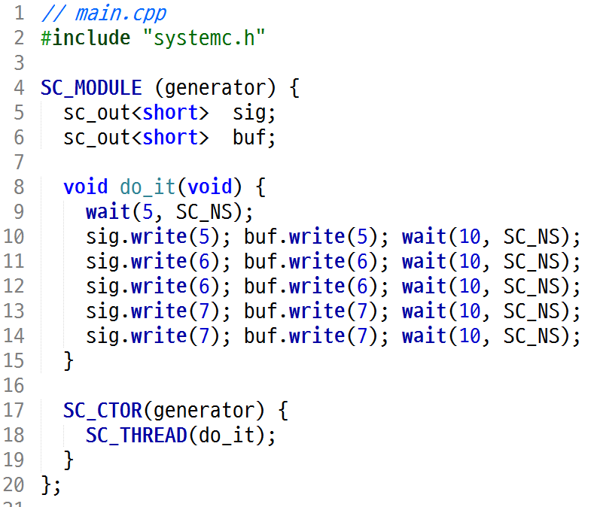
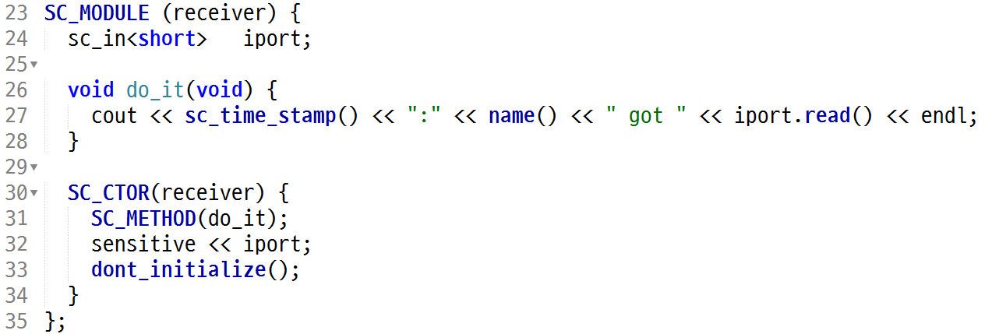
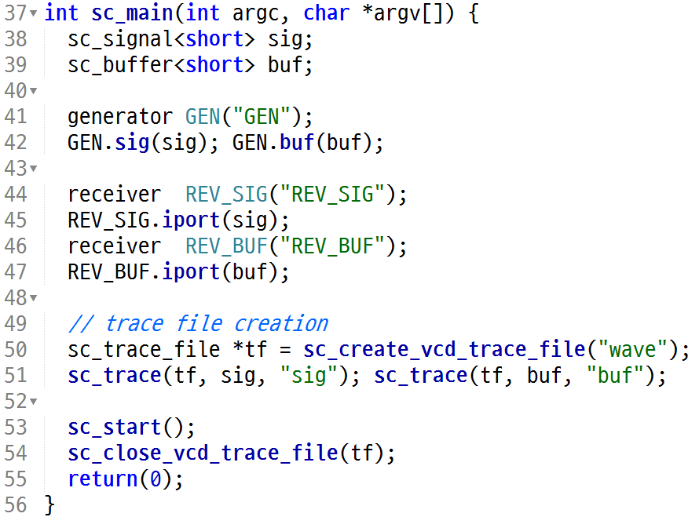
SystemC Examples-2

Slide 34
SystemC Examples-2 result
$ g++ -O3 -Wall -Wno-deprecated -g -I/usr/local/systemc/include -c main.cpp $ g++ -O3 -Wall -Wno-deprecated -g -I/usr/local/systemc/include -L/usr/local/systemc/lib-linux64 -o run.x main.o -lsystemc -lm 2>&1 | c++filt $ ./run.x SystemC 2.3.1-Accellera --- May 15 2015 17:35:02 Copyright (c) 1996-2014 by all Contributors, ALL RIGHTS RESERVED 0 s:REV_BUF got 0 5 ns:REV_SIG got 5 5 ns:REV_BUF got 5 15 ns:REV_SIG got 6 15 ns:REV_BUF got 6 25 ns:REV_BUF got 6 35 ns:REV_SIG got 7 35 ns:REV_BUF got 7 45 ns:REV_BUF got 7

Slide 35
Homework
By using SystemC, make your own components, test, and generate waveforms.
1)16bit counter
2) memory (size = 0x1000)
Deliverables
Report
Module design diagram
Source code (module + testbed)
Simulation result (including waveforms)
Tarball
Modules
Testbed
Working makefile
How to deliver
shkang@iris.snu.ac.kr
Title of the mail: [DSDM16] 20XX-XXXX homework submission
Deadline: 1st April

